Slide 1






Enterprise Master Data Management (MDM)
Governance Solution
Technical Proposal

Slide 2




















PiLog Group: Our strengths and credentials
300+
Global Customers
~30 Years
Experience
30+
Fortune-100 Customers
10+
Global Locations
7+ Years
Average Partnership
2
Laboratories
Top
Accreditations
~700
Global Talent
© PiLog Group
2
www.piloggroup.com
Restricted Use

Slide 3
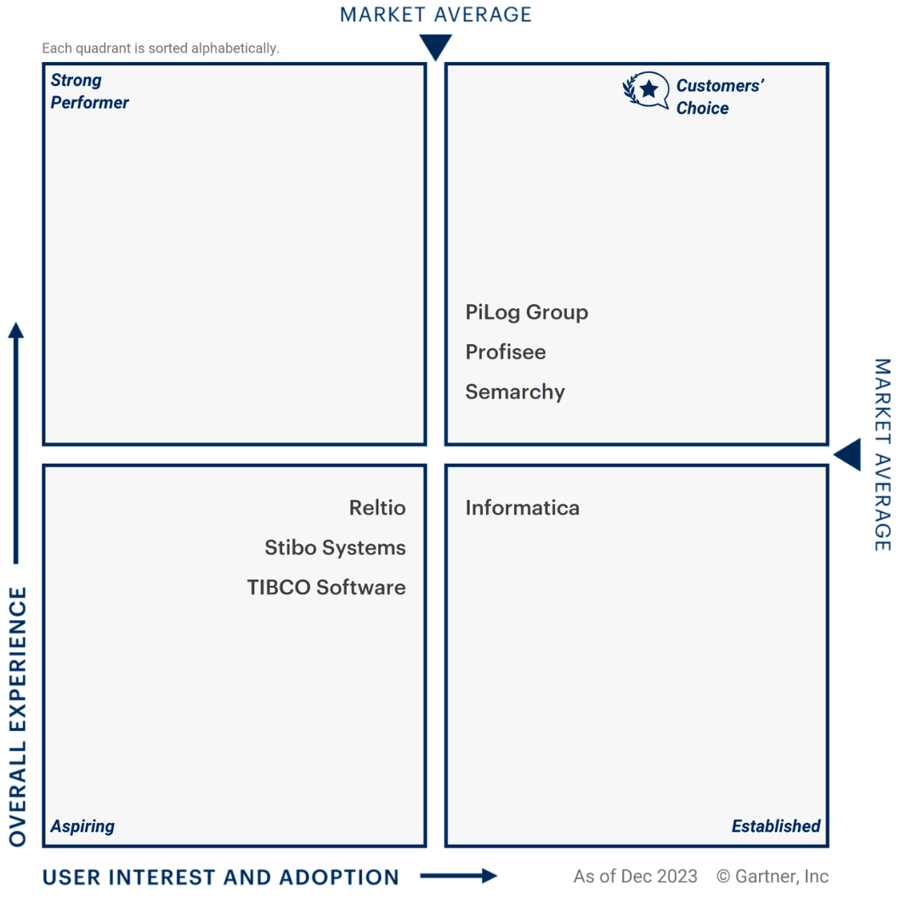
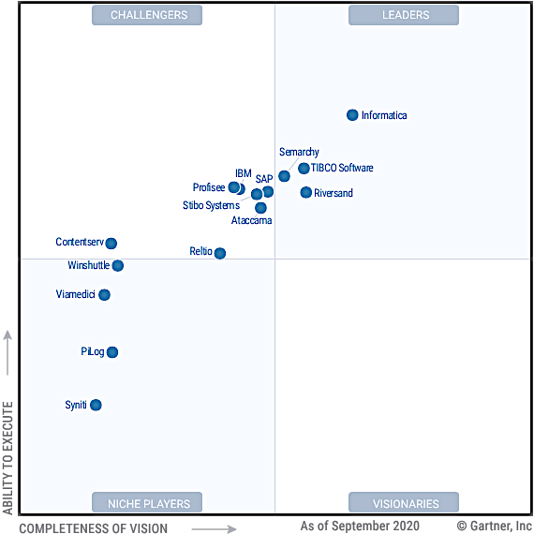
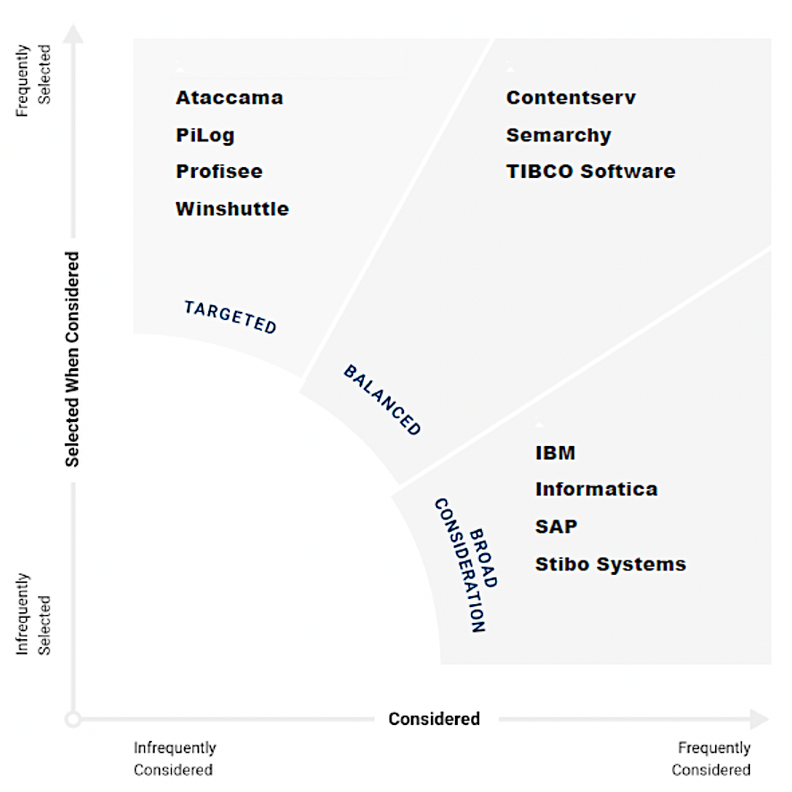
PiLog Recognitions
Gartner Peer Insights “Voice of the Customer” “Master Data Management Solutions “ Customers’ Choice Awards 2024
PiLog named as a “Niche Player” in the 2021 Gartner’s Magic Quadrant for
“Master Data Management Solutions”
PiLog named in Gartner’s Peer Insights Vendor Spectrum 2021 for “Master Data Management Solutions”
© PiLog Group
3
www.piloggroup.com
Restricted Use

Slide 4
Agenda
Use Case 1 – Single Equipment Creation (Governed Workflow)
• Class-based search & duplicate prevention • Equipment creation with validations & auto description • Parallel approval workflow • SAP PM integration
Use Case 2 – MOCR (AI-Driven Bulk EAM Processing)
• Bulk creation of FLoc, Equipment, BOM, Task Lists & Maintenance Plans • AI-assisted validation, enrichment • Bulk approvals & SAP integration
Use case 3 –Reporting & Dashboards
© PiLog Group
4
www.piloggroup.com
Restricted Use

Slide 5
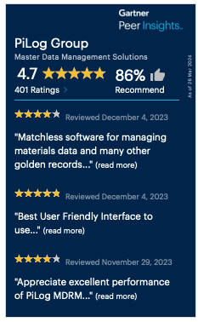



PiLog has been recognized and mentioned in market research
Market Guide for Master Data Management Solutions
Voice of the Customer for Master Data Management Solutions
Market Guide for MDM External Services
Magic Quadrant for Master Data Management Solutions
Toolkit: Vendor Identification and Selection Guide for AI and Data and Analytics (D&A) Service Providers
Hype Cycle for Data Management, 2024
Gartner Peer Insights ‘Vendor Spectrum’: Consideration of Master Data Management Solutions
Hype Cycle for ERP, 2024
Hype Cycle for Midsize Enterprises, 2024
© PiLog Group
5
www.piloggroup.com
Restricted Use

Slide 6

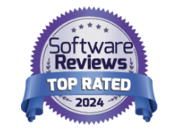
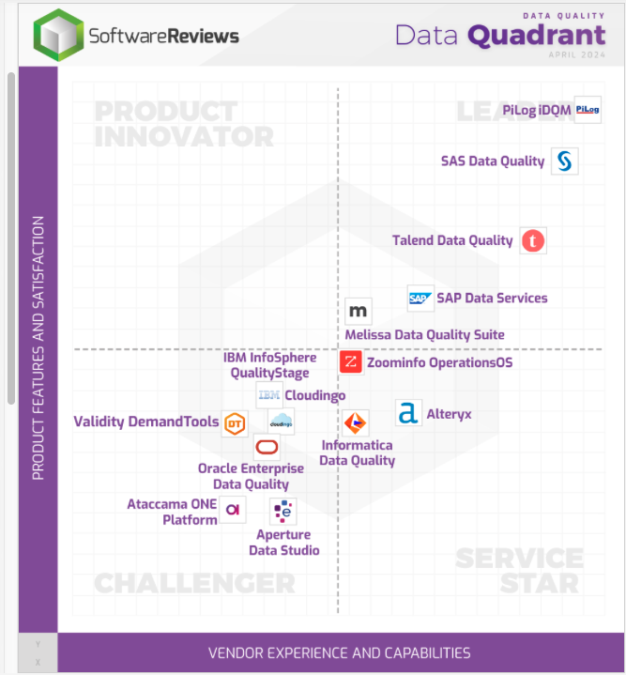
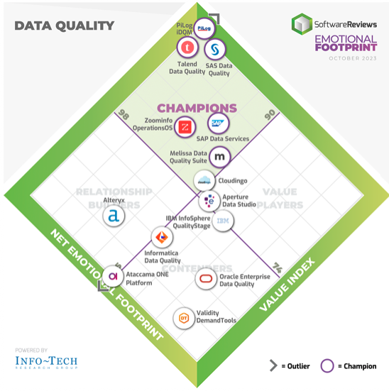




PiLog has been recognized and mentioned in prominent advisories and research organizations
PiLog’s solution won the following awards in the Data Quality category
Emotional Footprint Champion
2023, 2024
Data Quadrant Gold Medalist
2023 and 2024
© PiLog Group
6
www.piloggroup.com
Restricted Use

Slide 7
Value Engineering Portfolio
Data Quality Foundry
Enterprise Data/AI Strategy
EAM Objects: Floc, Eqpt, eBoM, fBoM, MI, TL, MP…
Enterprise Data Mgmt.
Data/AI Advisory
Data Migration / Upgrades
Capital Projects Management
[EPC: SPDP + iSPIR]
MRO Inventory Optimization
Asset Lifecycle Mgmt.
Supply Chain Mgmt.
Plant Maintenance Strategy
Value Engineering Portfolio
Services & Contracts Management [S2C]
Financial Assets Management
S2P, P2I, S2C, A2R, O2C: Business Process Optimization
Facilities Management
Digital Transformation & Robotic Process Orchestration
MDM: AMR/EMR, MMR, SMR, VMR, EAM etc.
Data Governance & Analytics
Sourcing, Category & Spend Mgmt.
Single Version of Truth
Spend & Category Management, Predictive & Strategic Procurement
Integration, Orchestration Business Services
Data Quality Hub: Orchestration, Consolidation & Reconciliation
Data Quality Mgmt.
Descriptive, Prescriptive & Predictive Analytics
BP Data Regulatory, Statutory Compliance & Cross-functional Governance
On-Cloud & On-Premise
BP Data Classification, Categorization, Industry Clusters
Data Quality Compliance, Data Maturity Audit
Data Cleansing, Classification & Enrichment
ISO: Meta Data, Taxonomy, Ontologies Assessment
NATO, eCl@ss, PIDX, eOTD, PPO, ISIC, HS etc.
© PiLog Group
© PiLog Group
7
www.piloggroup.com
Restricted Use
www.piloggroup.com

Slide 8








































PiLog Industry Experience(1/3)
Oil, Gas, and Energy
Industrial Manufacturing
Consumer Products
Public Sector
Telecommunication
© PiLog Group
8
www.piloggroup.com
Restricted Use

Slide 9








































































PiLog Industry Experience(2/3)
Mill Products, Mining & Chemicals
Aerospace & Defense
EC&O
© PiLog Group
© PiLog Group
9
www.piloggroup.com
Restricted Use
www.piloggroup.com

Slide 10
























PiLog Industry Experience (3/3)
Travel & Transport
Utilities
© PiLog Group
10
www.piloggroup.com
Restricted Use

Slide 11
Data & Analytics Governance – Organizational Strategy
3
Analytics & Business Performance
Consolidation & Collaboration
Establish the Digital Analytics platform
Design & Build the InfoGraphics for CXOs
Evaluate the performance of organization based on data insights (KPIs, SLAs etc)
Evaluate the benefits & establish the ROI
1
Acquire/Collect the data from various sources /systems /landscapes
Standardize / Harmonize the datasets using Industry-specific standards & taxonomies
Establish the Single Version Of Truth [SVOT]
Design & Establish the intelligent processes to address the newly generated /change records
2
Governance & Orchestration
Transform the processes to adapt the systematic data flow [Automated]
Assess, Monitor & Improve the Data Quality [Apply ISO Standards]
Establish centralized teams with strategic objectives for various processes
Enforce the governance principles across the organization
www.piloggroup.com
Restricted Use

Slide 12







Proposed Data Lifecycle Management Solution Architecture to HMEL…
Target Systems
[ERP, CRM, SRM, 3rd Party, On-Cloud, On-Premise]
Data Governance Solution
Data Sources
PiLog’s DQG Solution
ETL
Material Master (Products)
Service Master
Equipment Master
BoM
PM Masters
PiLog’s DQG Solution for Data Cleansing & Standardisation
Data Acquisition
Data Cleansing
Data Standardisation
Data De-Duplication
Data Upload to Target Systems
© PiLog Group
www.piloggroup.com
12
Restricted Use
Notes:
Change slide

Slide 13
“Data Cleansing Methodology for Material Master”
www.piloggroup.com
Restricted Use

Slide 14
Single Version of Truth – Data Cleansing
Data Acquisition from SAP
Extract & Validate Drawings data
Assign a Class (PPO)
Extract & Validate Reference Data
Extract & populate property values
Restructure Free text (FFT)
Standardize & Abbreviate values
Populate & Validate ERP data
Generate Structured Descriptions
Generate & Confirm Potential Duplicates
Approve & Upload to SAP
Single Version of Truth
© PiLog Group
14
www.piloggroup.com
Restricted Use
Notes:
14

Slide 15









Solution Architecture Framework
Data Source
Data Staging and Test Environment
Offline Validate & Load
Auto Structure Algorithms
Repository Records (PPR) & Data Libraries
Master Data Dictionary
Cleanse
Transformation
Data Quality Governance Suite (DQGS)
Materials
Extract
Business Rules
Legacy
Extract
Cleanse
Enrich & Transform
Data Quality Review
Standardization
De-Duplication
Industry Standards
Physical Inspection
Performance Analysis
Dashboards and Business Reporting
Data Health Assessment
© PiLog Group
15
www.piloggroup.com
Restricted Use

Slide 16
PiLog Preferred Ontology PPO (Taxonomy Standard) & Business Benefits…
PiLog through out the 30 years of experience in master data solutions across different industries have developed PiLog Preferred Ontology (PPO) which is a Technical Dictionary that complies with the ISO 8000 standard. The PPO is a best defined industry specific dictionary covering all industry verticals such as Aviation, Petrochemical, Iron & Steel, Oil & Gas, Cement, Transport, Utilities, Retail etc.
Each PPO class is a combination of object-qualifier or noun-modifier, which in turn is linked to either a material group or UNSPSC code depending on the customer requirement for the spend analysis. Each class in the PPO dictionary will have a set of properties/attributes with definition, abbreviation, mandatory flag and property sequence.
Business Benefits
Uniformity in Business Communication
Accurate & Cost Effective Sourcing
Unambiguous Identification
Consistent Sales & Purchase Order Descriptions
Potential Duplicate Identification
Visibility of Spend
Optimized Inventory & Supply-Chain Management
Standardized processes
PPO Consists of
Class
Characteristics
Characteristic Sequence
Mandatory Indicator
Class Definition
Characteristic Definition
Class Abbreviation
Characteristic Abbreviation
Description Generation Rules
Standard Values
Standard Value Abbreviations
PPO
(PiLog Preferred Ontology)
PRO
(Ontology of all PiLog Clients)
OTD Registry
(Over 1.4
million concepts)
OTD: Open Technical Dictionary
CPO
(Client/Corporate Preferred Ontology)
ISO 22745 & ISO 8000 Complaint
www.piloggroup.com
Restricted Use

Slide 17
PiLog Applied - Master Data Quality Standards (ISO 8000)
Data Portability
ISO 8000
Data Portability
Data Requirement
ISO 8000-110
Class/Concept Definition, unique identifier
Quality data is portable data; it is independent of the software application
Data Terminology & Localization
PPO: ISO 8000-110
Common Business Language
Data Classification
ISO 22745
Linking PPO class to classification (UNSPSC)
Provenance – Traceable History at record level
Data Traceability
ISO 8000-120
Property/Concept Definition, unique identifier
Business Requirements
Multi-lingual
Linking PPO class to classification (spend tree)
Technical Dictionaries & Exchange of Characteristics Data
ISO 29002
Technical Dictionaries
Exchange of characteristics data in xml format
Owner of the data created
ISO 8000
Master Data Quality
ISO 22745
Open Technical Dictionaries
ISO 29002
Exchange of Characteristics data
www.piloggroup.com
Restricted Use

Slide 18





Sample Data Harmonization/Cleansing Process (Material)….
Data Manager
Data Cataloguing
Data QA/QC
HMEL QA/QC
Batch
Release for Cataloguing
Data Review
Data Sampling
Acquire
Data
Load Data
Run Analyzers
Assign Class
Perform Value Standardization
Data Review
Capture and Enrich the property values
Run Description Generation
Data Approval/
Rework
Review Results
Capture Reference Info/Walkdown
Run QC Tools
Bad Data
Run QC Tools
Release to Client for Review
Prepare Batch
Export Data
Release for QC
SAP
PDR
© PiLog Group
18
Restricted Use

Slide 19
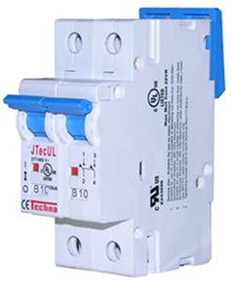
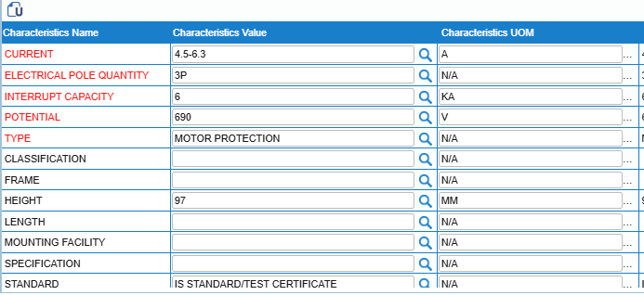
Examples of Data Cleansing Approach..
Assign Class
Class Name: Breaker, Circuit
Client Source: MPCB,6.3AMPS,RANGE:4.5-6.3A 3RV11211GA10
Populate Properties
Catalogued Short Description
CB;MD:3RV1121-1GA10,MP,4.5-6.3A,690V
Catalogued Long Description
BREAKER, CIRCUIT; TYPE: MOTOR PROTECTION, CURRENT: 4.5-6.3 A, POTENTIAL: 690 V, ELECTRICAL POLE QUANTITY: 3P, INTERRUPT CAPACITY: 6 KA, TEMPERATURE RANGE: -50 TO 80 DEG C, HEIGHT: 97 MM, STANDARD: IS STANDARD/TEST CERTIFICATE; FFT: RELAY RANGE: 4.5A-6.3 A, CLASS-10, SIRIUS; MODEL NO: 3RV1121-1GA10, MANUFACTURER: SIEMENS
© PiLog Group
19
www.piloggroup.com
Restricted Use

Slide 20
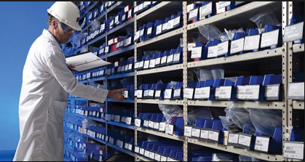
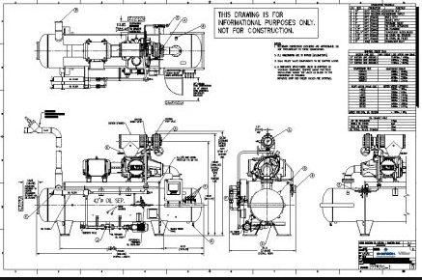



Material Master – Enrichment example…
Enrichment is the process of sourcing additional information about a material item from physical inspection or external sources like the internet, manufacturer catalogues or engineering drawings.
Item Number: 123456
Current Catalogue Description
BRG , NSK PN: 6206ZZC3 62*16 , 11979 FOR MOTOR
PiLog Data Repository
(10 Million Records)
Catalogued
BEARING, BALL:
TYPE: DEEP GROOVE
ROW: SINGLE
INSIDE DIAMETER: 30MM
OUTSIDE DIAMETER: 62MM
WIDTH: 16MM
CAGE MATERIAL: PRESSED STEEL
CLOSURE TYPE: SHEILDED
IBI: 11979
APPLICATION: MOTOR
BEARING, BALL:
OUTSIDE DIAMETER: 62MM
WIDTH: 16MM
IBI: 11979
APPLICATION: MOTOR
Enriched
P/N: 6206ZZC3 NSK
P/N: 6206ZZC3
Manufacturer: NSK
© PiLog Group
20
www.piloggroup.com
Restricted Use

Slide 21
Sample Catalogued Data (Generation of SAP Short Descriptions)
S.no | Source Description ( Short Text) | PiLog Catalogued Short Description
1 | CONTACTOR;SCHNEIDER ELECTRIC;LC1 D80G7 | CONTCTR;PN:LC1D80G7,80A,120VAC,5.1W
2 | BEARING # 7310-BECBP; DEMIN P/P2; SYS14 | BRG BALL;PN:7310BECBP,SNGL,50MM,110MM
3 | MOTOR CIRCUIT BREAKER GV2-L20 18A | CB;PN:GV2L20,MGNTC,18A,3P,50KA
© PiLog Group
21
www.piloggroup.com
Restricted Use

Slide 22
Potential Duplicate Resolution (PDR)
Potential Duplicates identification is the process to identify the duplicates across the material master data. There are two ways to identify the duplicates
PDR-1 is the process of identifying items that have same part number/model number
PDR-2 is the process of identifying materials that might not have part/model numbers but have the same mandatory properties
PDR-1 and PDR-2 will be performed after data cleansing
The success factor to identify more duplicates is Standardization
Standardization also enables more effective search functions, along with structured description generation, which leads to more effective purchasing
© PiLog Group
www.piloggroup.com
Restricted Use

Slide 23


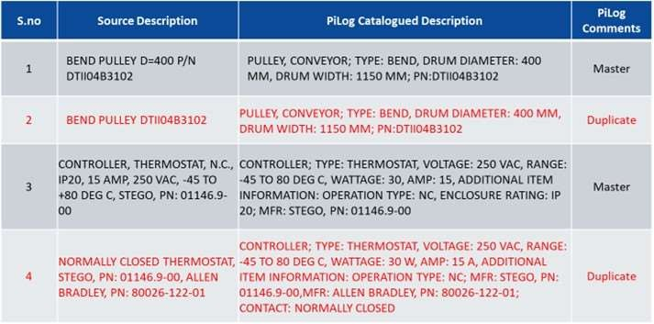
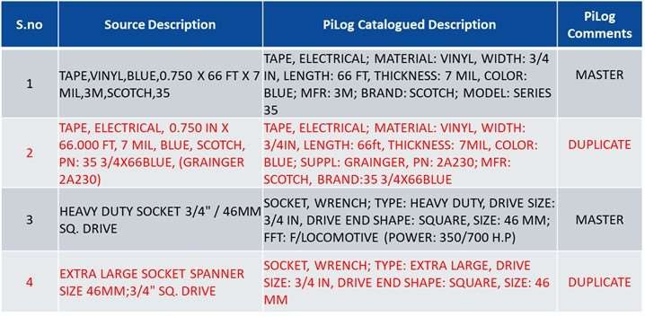
Data Cleansing | Potential Duplicate Resolution (PDR)
Potential duplicate identification is the process of identifying the duplicates across the material master data. There are two ways to identify the
duplicates.
PDR-1 is the process of identifying items that have the same part number/model number
PDR-2 is the process of identifying materials that might not have part/model numbers but have the same
PDR-1 and PDR-2 will be performed after data cleansing.
The success factor in identifying more duplicates is Standardization
Standardization also enables more effective search functions, along with structured description generation, which leads to more effective
purchasing.
PDR-1 PDR-2
mandatory properties
© PiLog Group
www.piloggroup.com
Restricted Use

Slide 24
Data Governance Solution Implementation
Background > Business Value of MDM
Background > Business Value of MDM
© PiLog Group
www.piloggroup.com
Restricted Use
24

Slide 25
“Data Governance Methodology for Material Master”
www.piloggroup.com
Restricted Use

Slide 26




Data Governance
PiLog’s lean data governance applies the principles of lean management to the governance of data within organizations. It focuses on ensuring that data-related processes are efficient, effective, and aligned with the organization's goals while minimizing time. Primarily Small and Medium businesses can benefit from this lean Architecture as well as extend it to Enterprise Level.
“
The Lean Data Governance Concept Promotes Three Significant Pillars.
Simple
Agile
Swift
DQG Suite integrates with S/4HANA on-premise and private cloud editions through SAP Cloud Foundry on BTP (CPI middleware APIs). Open and Cloud connector Architecture with API endures future scalability and interoperability with SAP and non-SAP suites for RISE & GROW programs
Preconfigured & Augmented Business & Data Content
Shift Left User Engagement models
Scalable Solutions & Architecture
Enables Multi Domain,
Tenant & Language
ERP / COTs agnostic Data
Mart & Interoperability
Deployed within few
weeks with Zero Flaws
Modular deployment
with ease
Measure & Realize Value
from Data Maturity &
Process Efficiencies
Plug and Play though
enabled on Cloud
Minimal Change
Management
Zero Disruption &
Maintenance
This conceptual approach is forged into a powerful product suite that has a complete set of tools to serve the event and data driven digital transformation that contemporary enterprises seek.
“
www.piloggroup.com
Restricted Use

Slide 27













PiLog’s Data Governance Solution Comprehensive data quality & governance solution powered by AI
Single or Mass Process
CREATE
Multi-Domain &
Multi-Lingual
Predefined Rules &
Processes
SAP Certified
S4 & RISE Integration
SAP Store
Cloud Ready
AI Agents
CHANGE
ISO Content + Industry-Proven Practices
EXTEND
SIMPLE – AGILE – SWIFT
DATA QUALITY
GOVERNANCE
DELETE
UNDELETE
BLOCK
UNBLOCK
MERGE
Requestor
Approver
Steward
Manager
LINK / REF
Asset
Service
Material
© PiLog Group
www.piloggroup.com
27
Restricted Use

Slide 28
Master Data Creation Process (Equipment or Material)
Requestor
Approver
Steward
Manager
Search
Record Found
No
CR – Create
(New Record)
Populate Characteristics
Review, Check, Process
Review, Check, Process
Review, Check, Process
Yes
Populate Part#, Model#, Reference, Document, SAP KDS
No
Use it
Duplicate Check
Auto-Generate Descriptions
Replicate
SAP ERP
Yes
Review & Process
Delete
Return
Restricted Use

Slide 29
DQG features- Service Template
PROVIDE: CEMENT CONCRETE, PLAIN
Definition: To provide or make available, a compound mixture of sand, broken stone pebbles and cement, formulated for specific construction casting requirements, available in dry, ready mix or mixed castable form.
TYPE | A subdivision into a particular classification. | M | 1
MIX RATIO | Indication of cement sand ratio. | M | 2
STONE SIZE | The nominal maximum size of aggregate stone. | M | 3
LOCATION | The geographical location where the task, service or activity is to be carried out as stipulated. | M | 4
RATE | The type of remuneration. e.g. NT= Normal Time; OT= Overtime; DT= Double Time; TT=Triple Time; etc. | M | 5
RATE TYPE | The type of remuneration applicable to the task. e.g. Travel; Accommodation; Substance; Mobilization; Comprehensive; Bulk; Inclusive; Standing Time; Material Handling; Cost +10%; Extra over; sundries; etc. | M | 6
METHOD | A means or manner of procedure, especially a regular and systematic way of accomplishing the task. | I | 7
ADDITIONAL INFORMATION | Any information relevant to the class having an impact on the result expected. | I | 8
ADDITIONAL EQUIPMENT | Any extra items / equipment that are required to complete the task. | I | 9
ADDITIONAL TASK | Any additional tasks that need to be carried out to complete the task. | I | 10
LABOR TYPE | The specific type of labor that is required to carry out the task. | M | 11
STANDARD | A technical standard is an established norm or requirement which is widely agreed upon or imposed by a governing body. It is usually a formal document that establishes uniform engineering or technical criteria, methods, processes and best practices. | I | 12
© PiLog Group
www.piloggroup.com
Restricted Use
29

Slide 30
Functional Location (FLOC) Hierarchical Structure with Centrifugal Pump
ISO 14224 Asset Hierarchy
A hierarchical pyramid of taxonomic classification
Plant [KD]
ISO 55000 Asset Management
Contains terminology and an overview of asset management standards
KD-F1 (Instrumentation)
KD-F2 (Mechanical)
KD-F1-01
(Sub-station)
KD-F1-02
(Gas Scrubber)
KD-F2-01
(Pump Station)
KD-F2-02
(Fuel Gas Scrubber)
Pressure Gauge
Level Gauge
Temperature Gauge
Level Switch
Centrifugal Pump
Check Valve
Relief Valve
Solenoid Valve
GAUGE, PRESSURE; CONNECTION SIZE: 1/2 IN, CONNECTION TYPE: NPT, MOUNTING METHOD: 1/2 IN PIPE, MEDIUM: GAS, APPLICATION: FUEL GAS SCRUBBER, PID NUMBER: K-004200; FOR TAG/EQUIP NO: 1800-AV-0010
GAUGE, LEVEL; CONNECTION TYPE: FLANGED, MEDIUM: GAS, APPLICATION: FUEL GAS SCRUBBER, PID NUMBER: K-004200; FOR TAG/EQUIP NO: 1800-AV-0010
GAUGE, TEMPERATURE; SIZE: 3/4 IN, APPLICATION: FUEL GAS PREHEATER, PID NUMBER: K-004200; FOR TAG/EQUIP NO: 1800-AE-0042
SWITCH, LEVEL; TYPE: HIGH, CABLE LENGTH: 1346 MM, APPLICATION: SOUR GAS SCRUBER, PID NUMBER: K-004200; FOR TAG/EQUIP NO: 1800-AV-0003
PUMP, CENTRIFUGAL; TYPE: OVERHUNG, TOTAL HEAD: 64.7 M, INLET CONNECTION SIZE: 8 IN, INLET CONNECTION TYPE: RAISED FACE FLANGED, OUTLET CONNECTION SIZE: 4 IN, OUTLET CONNECTION TYPE: RAISED FACE FLANGED, FLOW RATE: 20.4 L/S
VALVE, CHECK; TYPE: NORMALLY CLOSED, SIZE: 2 IN, MOUNTING METHOD: VERTICAL, CONNECTION TYPE: FLANGED, OPERATED: MANUALLY, APPLICATION: SCRAPER RECEIVER, MEDIUM: GAS, PID NUMBER: K-004200; FOR TAG/EQUIP NO: 1800-GR-V-0001
VALVE, RELIEF; TYPE: VACUUM, SIZE: 4 IN, MEDIUM: CRUDE/WATER, CONNECTION TYPE: FLANGED, MOUNTING METHOD: VERTICAL, APPLICATION: SURGE TANK, ADD INFO: PIPELINE: 4IN-RL-2923-1CS9P, PID NUMBER: K-004200; FOR TAG/EQUIP NO: 1800-TK-0081A
VALVE, SOLENOID; SIZE: 2 IN, STYLE: 3-WAY, MEDIUM: GAS, CONNECTION TYPE: FLANGED, MOUNTING METHOD: VERTICAL, APPLICATION: SCRAPER RECEIVER, ADD INFO: PIPELINE: 201-9CS6SO2-12IN-PG, PID NUMBER: K-004200; FOR TAG/EQUIP NO: 1800-GR-V-0001
41112412/Pressure Gauge
41111950/Level Indicator
41112222/Temperature Gauge
39122219/Float or Level Switch
40151503/Centrifugal Pumps
40141622/Inline Check Valves
40141606/Relief Valves
40141605/Solenoid Valves
www.piloggroup.com
Restricted Use

Slide 31

Material Criticality Methods
ABC Analysis
FSN Analysis
VED Analysis
XYZ Analysis
HML Analysis
SDE Analysis
Based on Consumption
Value per year
Based on Consumption
Rate
Based on Criticality
& Impact
Based on Stock Value
Accumulation
Based on Unit Price
of the Material
Based on Lead Time &
Availability of Items
Identify the objective and the
analysis criterion
Collect all the data about the
inventory and calculate the
consumption or sale value
Arrange all the consumption
values in the descending order
Create next column and start
adding the cumulative total of
consumption value
Assign the category based on
the accumulated value as A, B
& C
Classification is based on the
pattern of issues from stores
and is useful in controlling
obsolescence
Date of receipt or last date of
issue, whichever is later, is
taken to determine the number
of months which have lapsed
since the last transaction
Based on number of months/
years categorize as F, M & S
Identification of factors
essential for VED Analysis
Calculate the sum of Actual
working hours
Finding out how many times
the order was placed
Calculate the average working
hours
Place the items into V, E and D
categories
Identify the objective and the
analysis criterion
Collect all the data about the
inventory
Divide Item’s current stock value
(cost per piece) with the total
stock value (Total Cost)
Arrange all the consumption
values in descending order of
values
Create next column and start
adding the cumulative total of
consumption value
Assign the category based on
the accumulated value as X, Y
& Z
Prepare the list of items and calculate their unit cost, annual
demand and annual usage
Arrange items in the descending order of their unit cost
Calculate percentage of unit cost, cumulative of unit cost and then categories the inventory item
The cut-off lines are then fixed by the organization for deciding three categories
Plot the graph on the basis of cumulative unit cost and then categories the inventory items
Identify the objective and the
analysis criterion
Collect all the data about the scarcity and availability of the items
Identify the lead time in weeks/days
Arrange the values in the descending order
Assign the category based on the lead time as S, D & E
www.piloggroup.com
Restricted Use

Slide 32








PiLog DQG Suite On-Cloud/On-Premise Landscape
PiLog System Landscape (On-Premise)
DQG Suite Database Server:
Installed Database
Base tables data
Access Control
Roles, User & Security
Operational data
Classification data
1521
SSL
SAP (Private Cloud / On-Premise of Client / Public Cloud)
DB
WildFly App
Transfer to SAP
OData Services (API)
DQG Suite Application server
Real time integration with SAP
Direct call from DQG Suite (java)
to SAP Web service
AI Powered Processes
LLM
LAM
AI/ML Models
APIs
S4 HANA
Cloud
SAP Server:
In both the scenarios SAP will be either on Private Cloud or On-Premise of Client or Public Cloud
1521
SSL
OData Services (API)
Transfer to SAP
DB
WildFly App
PiLog System Landscape (On-Cloud)
PiLog integrates with SAP using SAP web services of SAP Accelerator Hub (APIs)
The SAP web service will be invoked from PiLog using ESB
SAP web services are called synchronous, each request, responses are maintained, updated in the system
Real-time integration would be implemented
www.piloggroup.com
Restricted Use
Notes:
PiLog’s Data Quality & Governance Suite deployment models on premise as well as on cloud on hyperscaler

Slide 33

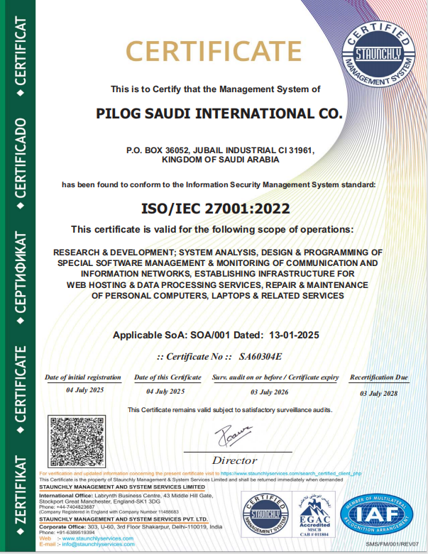
Cyber Security Certifications 1/2
www.piloggroup.com
Restricted Use

Slide 34
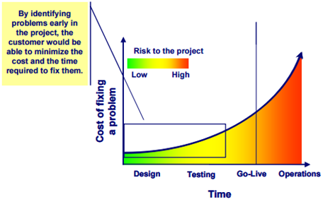
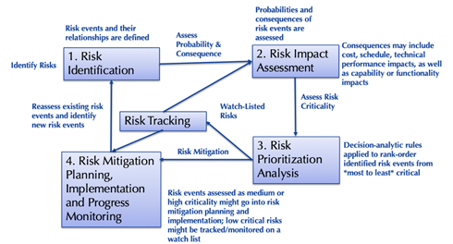
Project Management Methodology
Perceived Risks | Mitigation Plan
On Time Unavailability of master data impacting scope of Project during execution | Send the requirements during kickoff process Follow with Neom PMO, IT and Business Document during Month 1 with action plan Daily standup meeting to update progress
Delay on Quality Review and Approval of Master Data by Neom core team | Follow up with PMO for adhering to SLAs
Unavailability of Neom core team for training and testing | Block the calendars for training in advance Be part of core team to execute as Sprint War Room
Breakdown of Communication & Collaboration Mechanism impacting progress | Create communication groups for execution teams with PMO as reviewers Make use of technology for connection
PiLog
www.piloggroup.com
Restricted Use

Slide 35
PiLog DQG Suite On-Cloud/On-Premise Landscape
PiLog System Landscape (On-Premise)
DQG Suite Database Server:
Installed Database
Base tables data
Access Control
Roles, User & Security
Operational data
Classification data
1521
SSL
SAP (Private Cloud / On-Premise of Client / Public Cloud)
DB
WildFly App
Transfer to SAP
OData Services (API)
DQG Suite Application server
Real time integration with SAP
Direct call from DQG Suite (java)
to SAP Web service
AI Powered Processes
LLM
LAM
AI/ML Models
APIs
S4 HANA
Cloud
SAP Server:
In both the scenarios SAP will be either on Private Cloud or On-Premise of Client or Public Cloud
1521
SSL
OData Services (API)
Transfer to SAP
DB
WildFly App
PiLog System Landscape (On-Cloud)
PiLog integrates with SAP using SAP web services of SAP Accelerator Hub (APIs)
The SAP web service will be invoked from PiLog using ESB
SAP web services are called synchronous, each request, responses are maintained, updated in the system
Real-time integration would be implemented
www.piloggroup.com
Restricted Use
Notes:
PiLog’s Data Quality & Governance Suite deployment models on premise as well as on cloud on hyperscaler

Slide 36
Cyber Security Certifications 1/2
www.piloggroup.com
Restricted Use

Slide 37
Project Management Methodology
Perceived Risks | Mitigation Plan
On Time Unavailability of master data impacting scope of Project during execution | Send the requirements during kickoff process Follow with Neom PMO, IT and Business Document during Month 1 with action plan Daily standup meeting to update progress
Delay on Quality Review and Approval of Master Data by Neom core team | Follow up with PMO for adhering to SLAs
Unavailability of Neom core team for training and testing | Block the calendars for training in advance Be part of core team to execute as Sprint War Room
Breakdown of Communication & Collaboration Mechanism impacting progress | Create communication groups for execution teams with PMO as reviewers Make use of technology for connection
PiLog
www.piloggroup.com
Restricted Use

